Slide 1

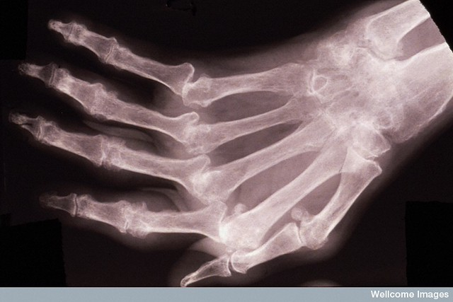
Rheumatoid arthiritis detection using machine learning
SUBMITTED BY-
Ananya Pradhan of 1CSE1
ADMISSION NUMBER-
25SCS1003000489
SUBMITTED TO-
Mr. Shobhit
This Photo by Unknown Author is licensed under CC BY-NC

Slide 2
INDEX
Introduction
Literature Review
Methodology
Implementation
Results and Discussion
Conclusion and future scope
References

Slide 3
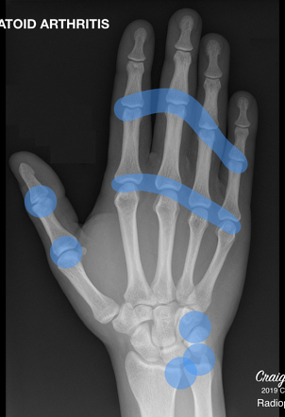
INTRODUCTION
1.1 OVERVIEW
Rheumatoid arthritis (RA) is a chronic autoimmune disease that causes inflammation of joints, leading to pain, stiffness, and potential joint damage.
Early detection of RA is critical because timely treatment can help prevent irreversible joint damage and improve long-term outcomes
Traditional diagnostic methods rely on clinical evaluation, lab tests (e.g., rheumatoid factor, anti-CCP antibodies) , imaging (like X-rays), and physician expertise. These methods can be time-consuming, sometimes subjective, and may not detect early disease.
Machine learning offers a powerful tool to analyze large, multidimensional datasets — including electronic health records (EHR), lab data, imaging, and even genomics — to find patterns that might indicate RA much earlier or more accurately than traditional methods.
However, there are challenges: model interpretability, generalizability, overfitting, data quality, and clinical integration remain major obstacles.
This Photo by Unknown Author is licensed under CC BY-SA-NC

Slide 4

1.2 Objectives
Develop a machine learning model that can classify patients as having RA (vs not) using clinical data, lab results, and/or imaging.
Improve early detection of RA, ideally before pronounced symptoms or radiographic damage.
1.3 PROBLEM STATEMENT
Rheumatoid arthritis is a progressive autoimmune disease that is difficult to diagnose early using conventional clinical, lab, and imaging methods.
This Photo by Unknown Author is licensed under CC BY-NC

Slide 5
LITERATURE REVIEW
There is growing interest in applying machine learning (ML) and artificial intelligence (AI) to RA for various tasks: diagnosis, prognosis, treatment response, and radiographic scoring.
A bibliometric study of AI in rheumatic diseases showed increasing research trends, especially in RA, with hotspots around early diagnosis, management, and personalized medicine.
However, despite progress, there are significant challenges: small datasets, lack of standardization, interpretability, and clinical translation.

Slide 6
S.NO | AUTHOR’s NAME [year] | DATASET | ALGORITHM & TECHNIQUE | ERRORLOADING MECHANISM | RESULT | REMARK
1. | Hajar Moradmand & Lei Ren [2025] | https://www.nature.com/articles/s41598-025-86073-0 | automated radiographic overall Sharp Scoring (AROSS) framework | Root Mean Squared Error (RMSE) Huber Loss | After training a U-Net model on a dataset of hand images, we achieved precise segmentation of the hand region from the background in each radiographic image | This study enhances automated joint assessment in rheumatoid arthritis through deep learning.
2. | Xiaoli Hu, Xianmei Liu, Yuan Xu, Shuai Zhang, Jun Liu & Shi Zhou [2025] | https://link.springer.com/article/10.1007/s10067-025-07304-3 | Random Forest (RnFr) | SHAP (SHapley Additive exPlanations) analysis | Of the 432 patients, 152 (35.2%) progressed to the RA group, while 280 (64.8%) remained in the non-RA group | Integrating the US18 assessment with clinical data in an RnFr model significantly improves early detection of RA progression in UA patients, offering potential for earlier and more personalized treatments.
3. | Rongheng MaLiping ZhouShuang JiangXiaojiao ZhaoRuiyao MaJin SunLing XiaXu LiuXiaoting WangQingyu MengHuimin YuYang Li [2025] | https://pubs.acs.org/doi/abs/10.1021/acs.analchem.5c00023 | Bayes, linear discriminant analysis, decision trees, k-nearest neighbors, random forests | Feature Importance Analysis | The design significantly enhances diagnostic precision and speed, enabling nonspecialists to accurately diagnose RA. Extensive experimental data validated the method’s 100% diagnostic accuracy. | This approach provides a novel and effective tool for early RA screening and demonstrates potential applications in other autoimmune and dermatological diseases.
4. | Jiao Qiu, Yalin Xu, Luyuan Tong, Xingchun Yang & Xiao Wu [2025] | https://www.nature.com/articles/s41598-025-05757-9 | Logistic Regression (LR) | single-sample gene set enrichment analysis (ssGSEA) | Through the LASSO analysis, three characteristic genes were obtained from the GSE55457 dataset with an Area Under the Curve (AUC) value of 0.985. | Studies have indicated that the primary cause of renal insufficiency in patients with rheumatoid arthritis (RA) is the nephrotoxicity associated with RA treatment, such as the use of nonsteroidal anti-inflammatory drugs (NSAIDs) and disease-modifying antirheumatic drugs (DMARDs).
5. | Mikko S Venäläinen, Alexander Biehl, Milja Holstila, Laura Kuusalo, Laura L Elo [2025] | https://academic.oup.com/rheumatology/article/64/3/1068/7643527 | automated RA scoring algorithm (AuRA) | Class Activation Mapping (CAM) / Grad-CAM | In the external validation cohort, with a root mean square error (RMSE) of 23.6, AuRA outperformed both top-performing RA2-DREAM algorithms (RMSEs 35.0 and 35.6). | AuRA had the best external validation performance and demonstrated potential for detecting longitudinal changes in joint damage
6. | Karolina KrystynaKopeć,Gabrieleanselmo Uccheddu,Paweł Chodnicki,Antonio Noto,Cristina Piras,Martina Spada,Luigi Atzori,Vassilios Fanos [2025] | https://www.mdpi.com/2218-1989/15/2/112 | Decision forests and random forest classifiers | Shapley additive explanations (SHAP) | Decision forests and random forest classifiers, optimized using genetic algorithms (GAs), highlighted a selection of a few metabolites—primarily glutamine, pyruvate, and proline—with significant discriminative power | This workflow could streamline diagnostic efficiency and enhance clinical decision-making in rheumatology.
7. | Zihan Wang, Tianyi Lan, Yi Jiao, Xing Wang, Hongwei Yu, Qishun Geng, Jiahe Xu, Cheng Xiao, Qingwen Tao [2025] | https://link.springer.com/article/10.1186/s13075-025-03576-x | several machine learning algorithms | van der Heijde-modified total Sharp score (mTSS) | The median increase in mTSS was 3.50. Of the 774 detected metabolites, 77 differed between patients with different outcomes. | The CjBM was developed for early prediction of bone destruction in patients with RA, and the evaluation of BERS emphasizes the significance of metabolite features.
8. | Mahyar Daskareh and associate researchers ^{[2024]} | https://www.mdpi.com/2075-4418/14/11/1181 | random forest (RF) | k-fold cross-validation (k = 5) and a comprehensive set of metrics, including sensitivity, specificity, precision, the F1-score, and the Matthews correlation coefficient (MCC) | The patients who developed RA (RA group) were significantly older on average (47.10 years, 95% CI: 45.32–48.88) compared to those who did not develop RA (non-RA group) (43.90 years, 95% CI: 42.49–45.31; p = 0.019). | This prospective cohort study exhibits the significance of targeted hand ultrasonography in the identification of individuals with a strong likelihood of advancing to rheumatoid arthritis.
9. | Wei Shuai and associate researchers [2024] | https://www.sciencedirect.com/science/article/pii/S1572100023006129 | multi-scale convolutional neural network (MSCNN) | Ensemble / Stacking Diagnostics | Spectral analysis shows that the curves and waveforms of the three spectral graphs are similar. The main differences are distributed in the spectral regions of 3300–3250 cm−1, 3000–2800 cm−1, 1750–1500 cm−1, and 1500–1300 cm−1 | The study demonstrated the superiority of MSCNN in distinguishing ankylosing spondylitis from rheumatoid arthritis and healthy controls.
10. | Tahereh Hassanzadeh and associate researchers [2024] | https://www.sciencedirect.com/science/article/abs/pii/S1746809423010455 | U-Net-based model | Change detection | a deep learning-based model is proposed to detect inflammatory changes in Rheumatoid Arthritis from MRI scans. | The proposed model is a combination of a convolutional neural network for image reconstruction and classical image processing techniques.
11. | Grzegorz Dudek and associate researchers [2024] | https://journals.plos.org/plosone/article?id=10.1371/journal.pone.0300717 | Logistic regression (LR), k-nearest neighbors (kNN), naïve Bayes (NB), decision tree (DT), boosted trees (BT), multilayer perceptron (MLP), and support vector machine (SVM). | RMSE | these models are particularly efficient in their ability to accurately classify data while also requiring relatively little time to train. | ML algorithms can effectively handle complex genomic data and identify predictive patterns for RA
12. | R K Ahalya, Snekhalatha Umapathy and Alex Noel Joseph Raj [2022] | https://journals.sagepub.com/doi/abs/10.1177/09544119221109735 | CNN-based computer-aided diagnostic tool | Class Activation Mapping (CAM) / Grad-CAM | The accuracy of the modified pre-trained model GoogLeNet was 89% and the proposed custom model three achieved an accuracy of 95%. | a custom CNN-based computer-aided diagnostic tool can be used as an effective method for the detection of RA.
13. | Kemal Üreten & Hadi Hakan Maraş [2022] | https://link.springer.com/article/10.1007/s10278-021-00564-w | You Only Look Once (YOLO) algorithm was used to obtain hand images from original radiographs without data loss | confusion matrix, and AUC (area under the ROC curve) | In the classification of rheumatoid arthritis and normal hand radiographs, 90.7%, 92.6%, 88.7%, 89.3%, and 0.97 accuracy, sensitivity, specificity, precision, and AUC results, respectively | This computer-aided diagnosis method can assist clinicians in interpreting hand radiographs, especially in rheumatoid arthritis and osteoarthritis.
14. | Sara Momtazmanesh, Ali Nowroozi & Nima Rezaei [2020] | https://link.springer.com/article/10.1007/s40744-022-00475-4 | Random forest, SVM, neural networks, and natural language processing (NLP) | Feature Importance Analysis | not all aspects of the pathways involved in RA pathogenesis are known (133), mainly due to the complexity and extensiveness of involving factors | Identifying patients for whom non-biological DMARDs are safe and effective substitutes using AI algorithms can be immensely helpful considering the higher cost of bDMARDs and their unavailability to many patients
15. | Mohammed Fadhil Mahdi , Arezoo Jahani , Dhafar Hamed Abd [2025] | https://www.sciencedirect.com/science/article/pii/S2352340925003555?via%3Dihub | Arthritis and Rheumatology, Machine Learning | Confusion Matrix | Age and sex features are complete, with no missing data. However, continuous features such as ESR, CRP, RF, and anti-CCP have missing data ranging from 9% to 27% | Despite the uniqueness of our dataset, we identified three limitations that can impact the performance of the training model. First, the dataset has an imbalanced class distribution, which can bias the model toward the majority class and reduce its generalization to minority classes.

Slide 7
methodology
1. Problem Definition
Problem: Rheumatoid arthritis (RA) is an autoimmune disease that is often diagnosed late or with uncertainty because of reliance on clinical judgment, lab tests, and imaging. Misdiagnosis or delays can lead to irreversible joint damage.
Goal: Develop a machine-learning model, specifically a Random Forest classifier, to detect RA using multimodal patient data (clinical features, labs, imaging, etc.), with high sensitivity and specificity. The model should also be interpretable so clinicians can trust and act on its predictions.
2. Data Collection & Preprocessing
Data Collection: a dataset of patients (RA and controls) with their clinical, lab, and imaging data is gathered.
Data Cleaning
Handling missing values: impute missing clinical/lab data using Random Forest imputation
3. Model Development — Random Forest
4. Building pipeline
5. Training the model
6. Evaluating on test data
7. Saving the trained pipeline/model

Slide 8
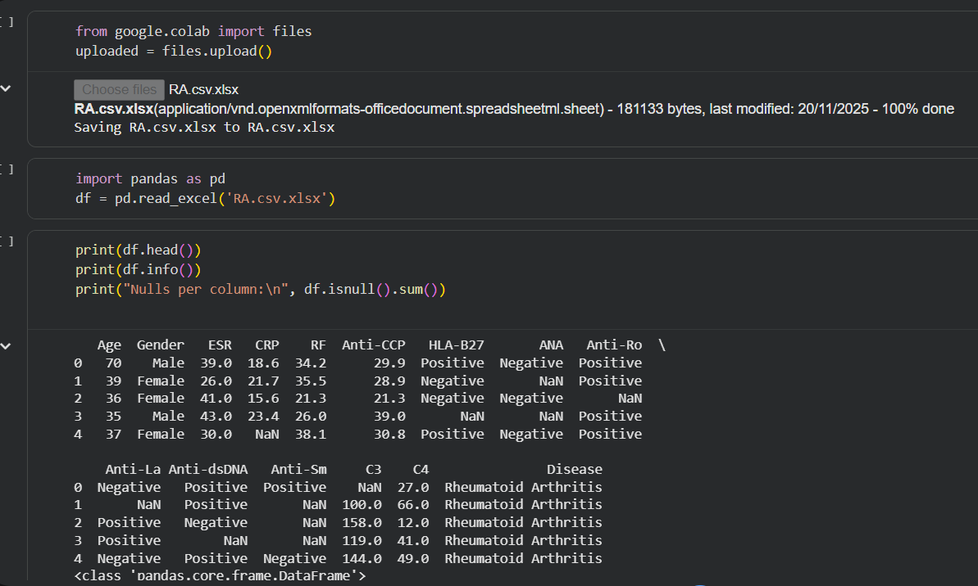
implementation
Python is used for implementation

Slide 9
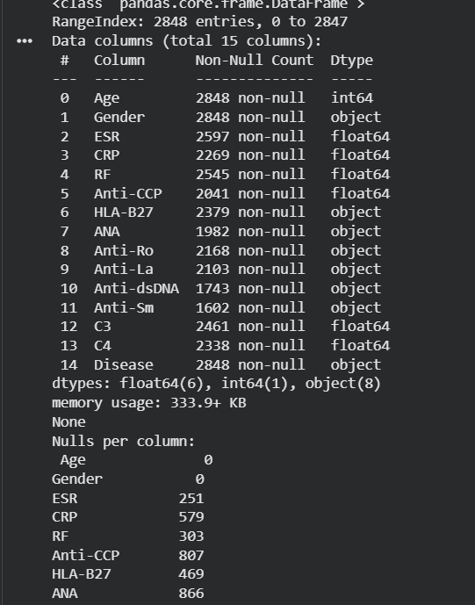
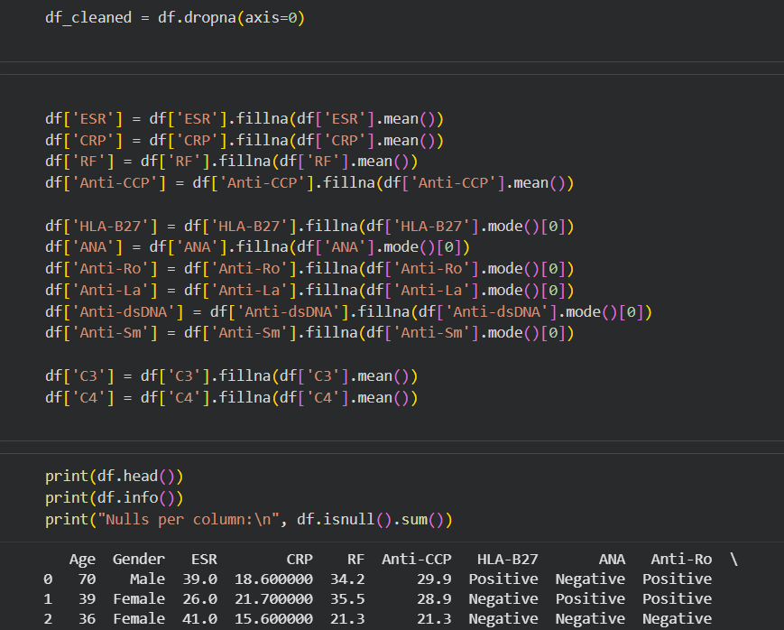

Slide 10
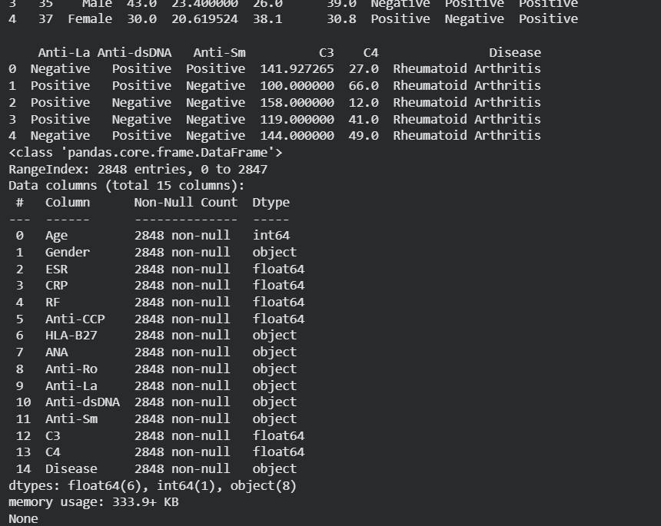
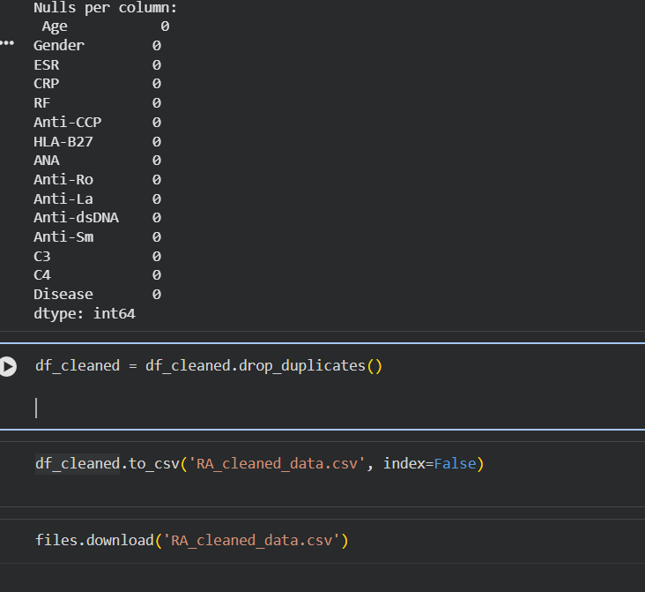

Slide 11
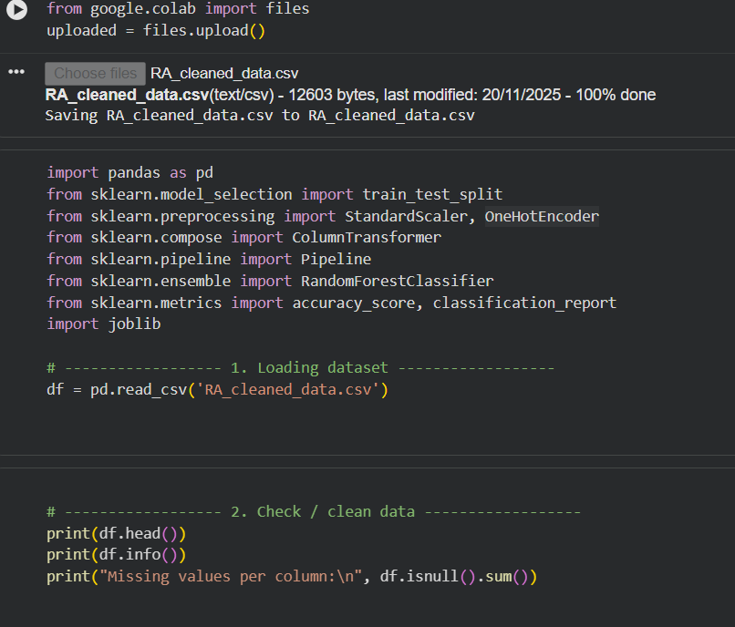

Slide 12
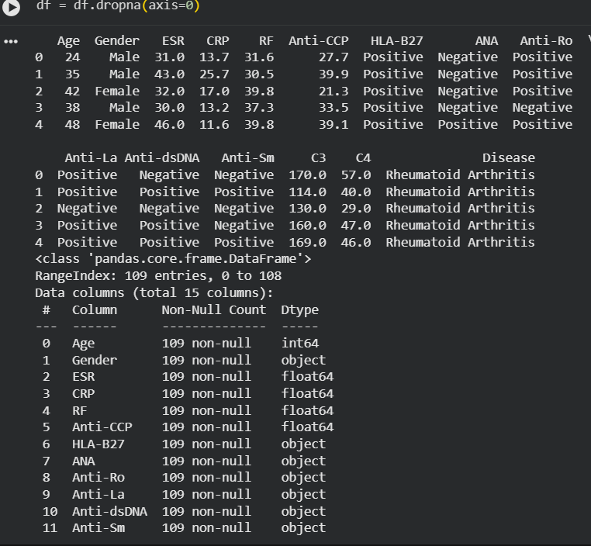

Slide 13
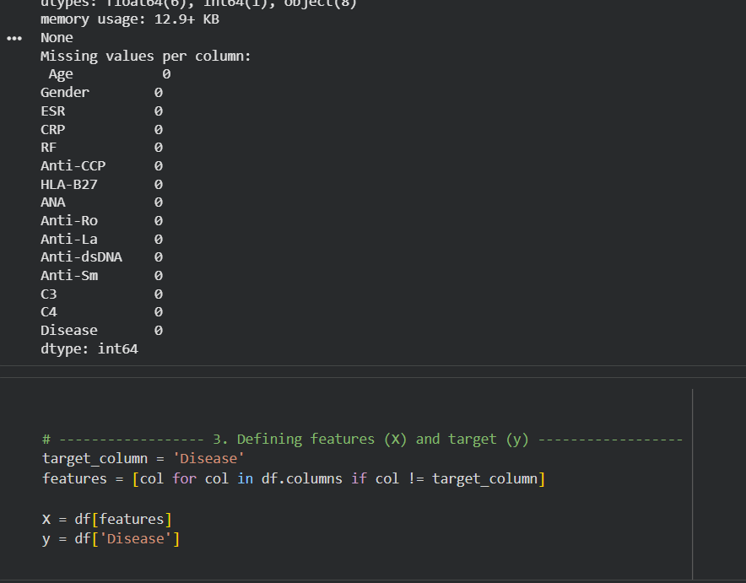

Slide 14
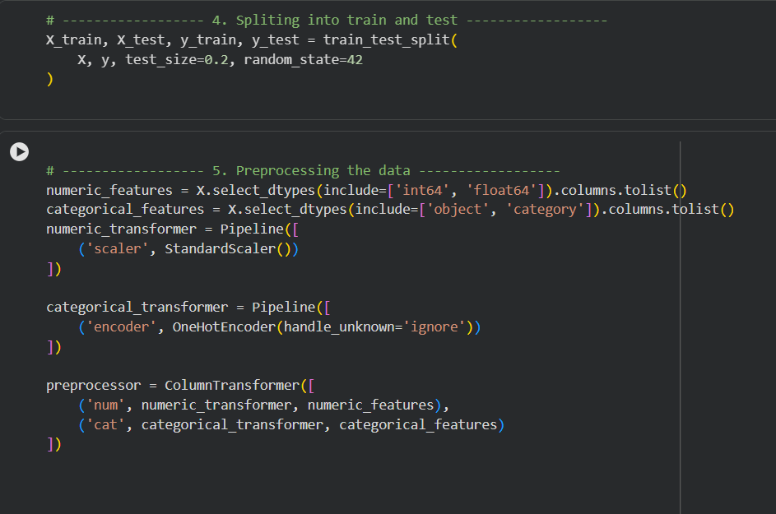

Slide 15
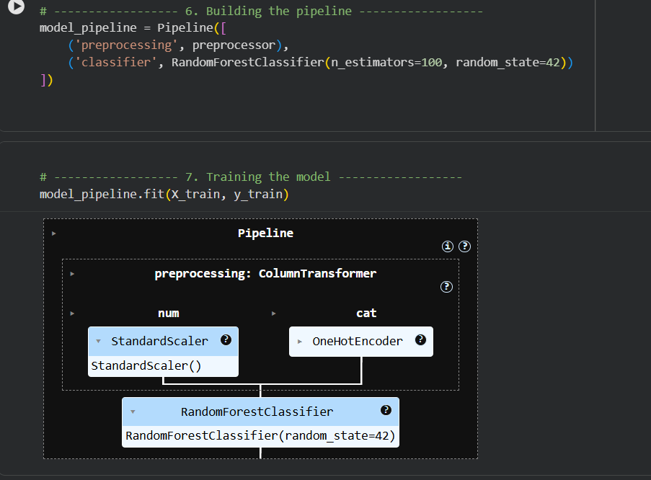

Slide 16
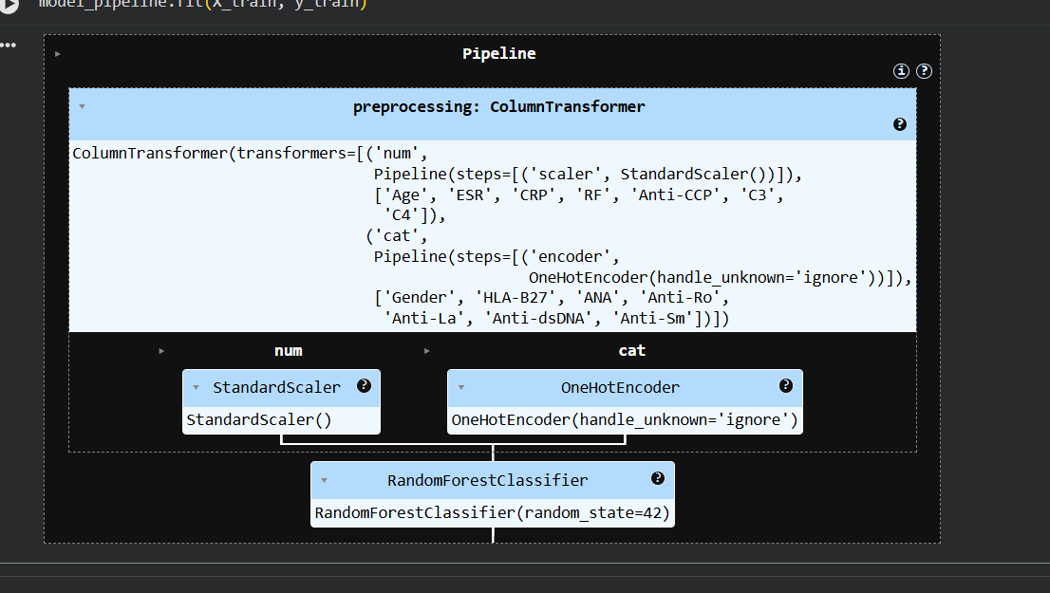

Slide 17
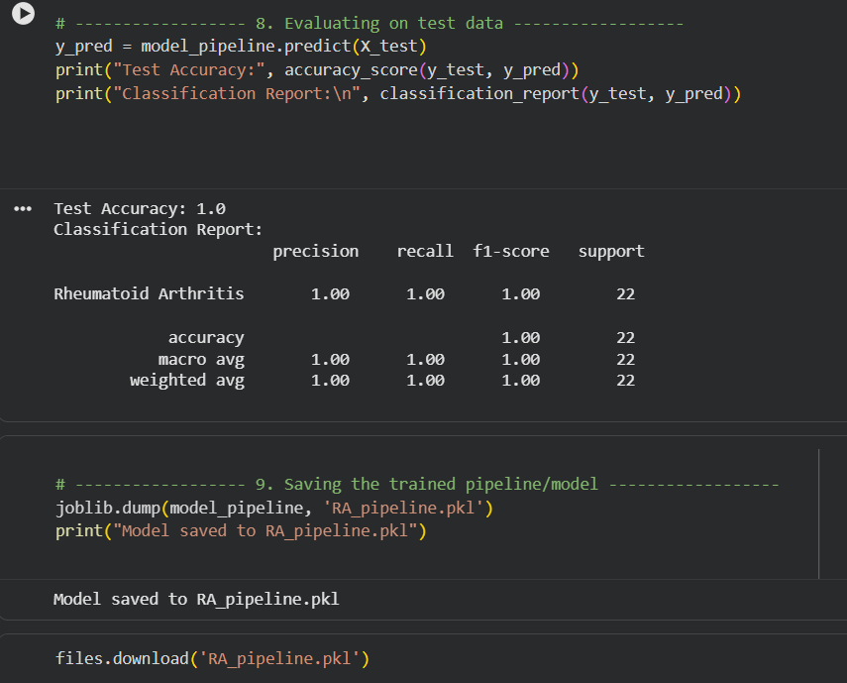

Slide 18
RESULTS AND DISCUSSION
Measuring disease activity is crucial in choosing the optimal treatment plan, determining response to therapy, and prognosis. Moreover, predicting disease severity early on could assist in timely administration of the most suitable medications.
The model’s false positives suggest a risk of over-diagnosing RA in patients with borderline abnormalities — this could lead to unnecessary referrals or anxiety. In a clinical deployment, one might mitigate this by using a higher decision threshold or combining model predictions with clinician judgment.

Slide 19
CONCLUSION AND FUTURE SCOPE
This study shows that ML tools could help doctors find rheumatoid arthritis faster and more accurately. But to really use it in hospitals, we need to test the model on data from other clinics (external validation) and make sure its probability estimates are well‑calibrated — meaning the model’s predicted risk matches the real risk.
FUTURE SCOPE
Include joint images (X-rays, ultrasound) so the model can understand damage to joints better.
Use AI to forecast how patients will respond to treatments (like methotrexate or biologics) using their medical history.
Develop AI tools that automatically score joint damage (e.g., Sharp score) from X-ray images — this saves time and reduces human error.

Slide 20
REFERENCES
scholar.google.com
colab.research.google.com
https://pmc.ncbi.nlm.nih.gov

Slide 21
Thank you
ANANYA PRADHAN
1CSE1
25SCS1003000489

